Slide 1
The Beginning of XAS Analysis
Tian Chen

Slide 2
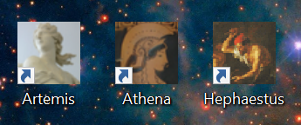
The software we need - Athena
Where to download: https://bruceravel.github.io/demeter/
It includes: Athena (mainly use this), Artemis, and Hephaestus
If you want more detailed guidance document, you can visit this website: https://bruceravel.github.io/demeter/documents/Athena/index.html#

Slide 3
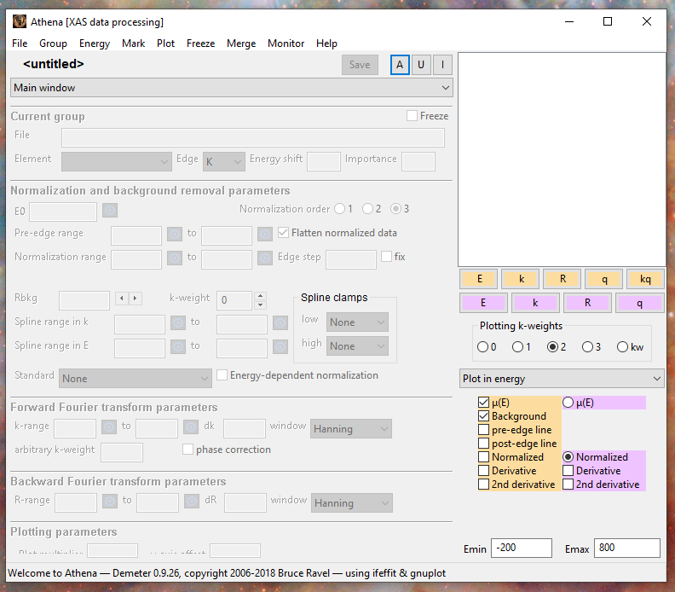
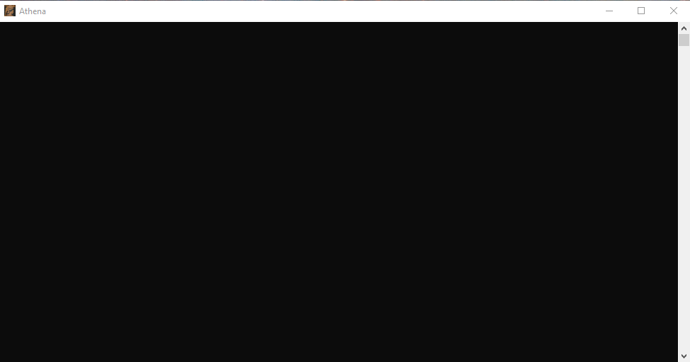
Start from the interface of Athena
Once you double click and open Athena software, you will see this interface.
And at the same time there is a black command panel with this interface, please be attention, don’t close it whenever you are processing data by Athena

Slide 4
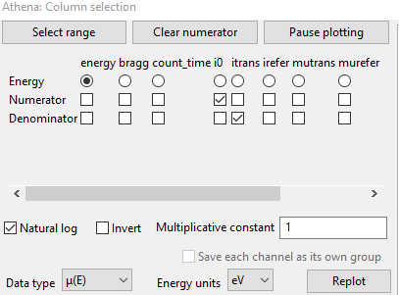
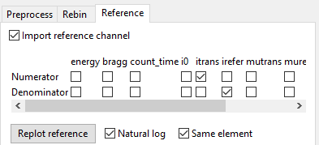
Export data
Go to “File” – “import data”, choose the data set you want to process, usually the suffix is “.xdi”. For example,
Then you will get a interface to adjust the data you want to import, please follow this setting.
And if you want to import your reference data, you can tick this.

Slide 5


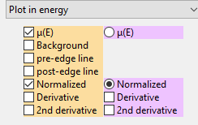
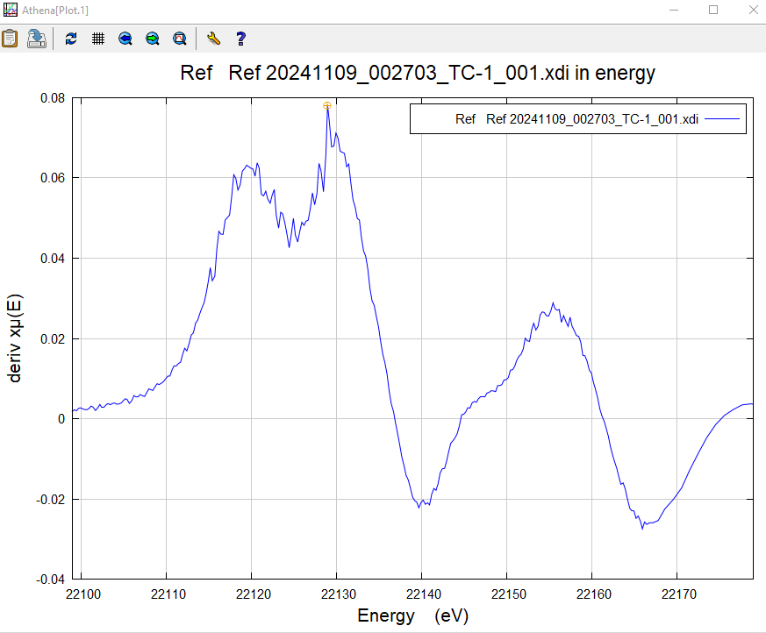
Calibration data
The first thing is to calibrate the data. Go to “main window” and scroll down to “calibrate data”.
There is another screen to show the plot, to calibrate your data, click this and do this
Then you will get a plot similar like this
Click “select a point”, choose the highest peak as your calibrate point and click “calibrate”

Slide 6



Pre-edge and post-edge range
Go back to main window, don’t forget to adjust the parameter here
The what you need to do is to select the ranges for your pre-edge and post-edge. You can tick those options to see your current ranges.
Use these target buttons to choose the point on the plot to pick your ranges.

Slide 7

Pre-edge and post-edge range
If your data has a good quality, basically you can use the default range directly. However, if you data quality is not so good, please play with the range by yourselves.
You can use the edge step to determine whether your range is well selected. Usually, if the edge step > 0.3, that means your ranges for pre-edge line and post-edge range are well selected.

Slide 8
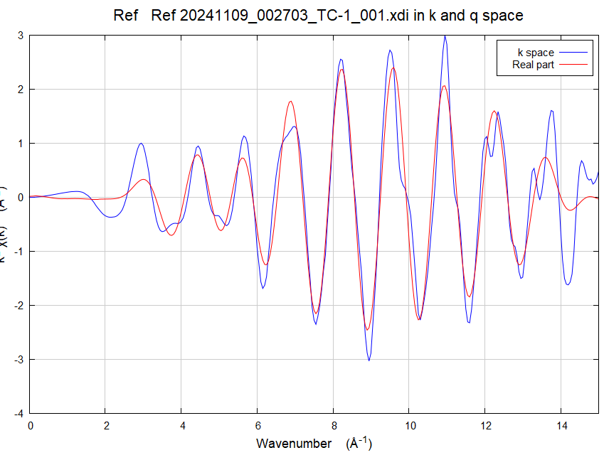
Process data
Parameters you can play with | Attentions
Rbkg | Adjust from 1.0 ~ 2.0
Spline range in k | Depends on your data
K-range | You can adjust from 3 ~ 15
Finally, how to know whether your data processing is OK? You can check by whether the data in kq space can be fitted.

Slide 9
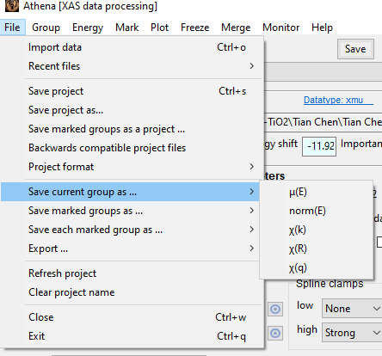
Export data
Norm(E)-energy, Χ(k)-k space, Χ(R)-R space
The exported data (.chik, .chir, etc) can be opened by Notepad

Slide 10
Wavelet transform
To analysis wavelet transform, you need the processed data for k space (Χ(k))
There are several ways to obtain wavelet transform. The following link provide three common methods: HAMA Fortran, IGOR Pro, Python
https://www.esrf.fr/UsersAndScience/Experiments/CRG/BM20/Software/Wavelets
But in this instruction, will use Matlab script to process.

Slide 11
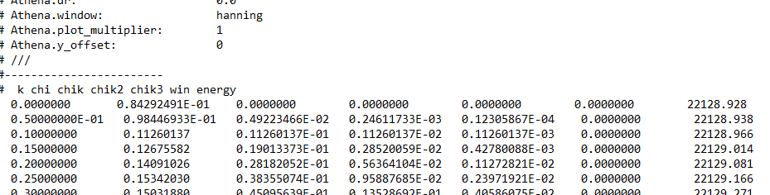
Treatments for k space data
Once you process and get the .chik data for your k space, open it by notepad, and you will see the data like this.
What you need are only the columns of k and chik (1st and 3rd).
So you can copy paste your data by Excel, Origin or whatever you prefer.

Slide 12
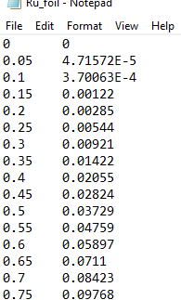
Treatments for k space data
Once you get these two columns of data, rearrange and collate them in a text file

Slide 13
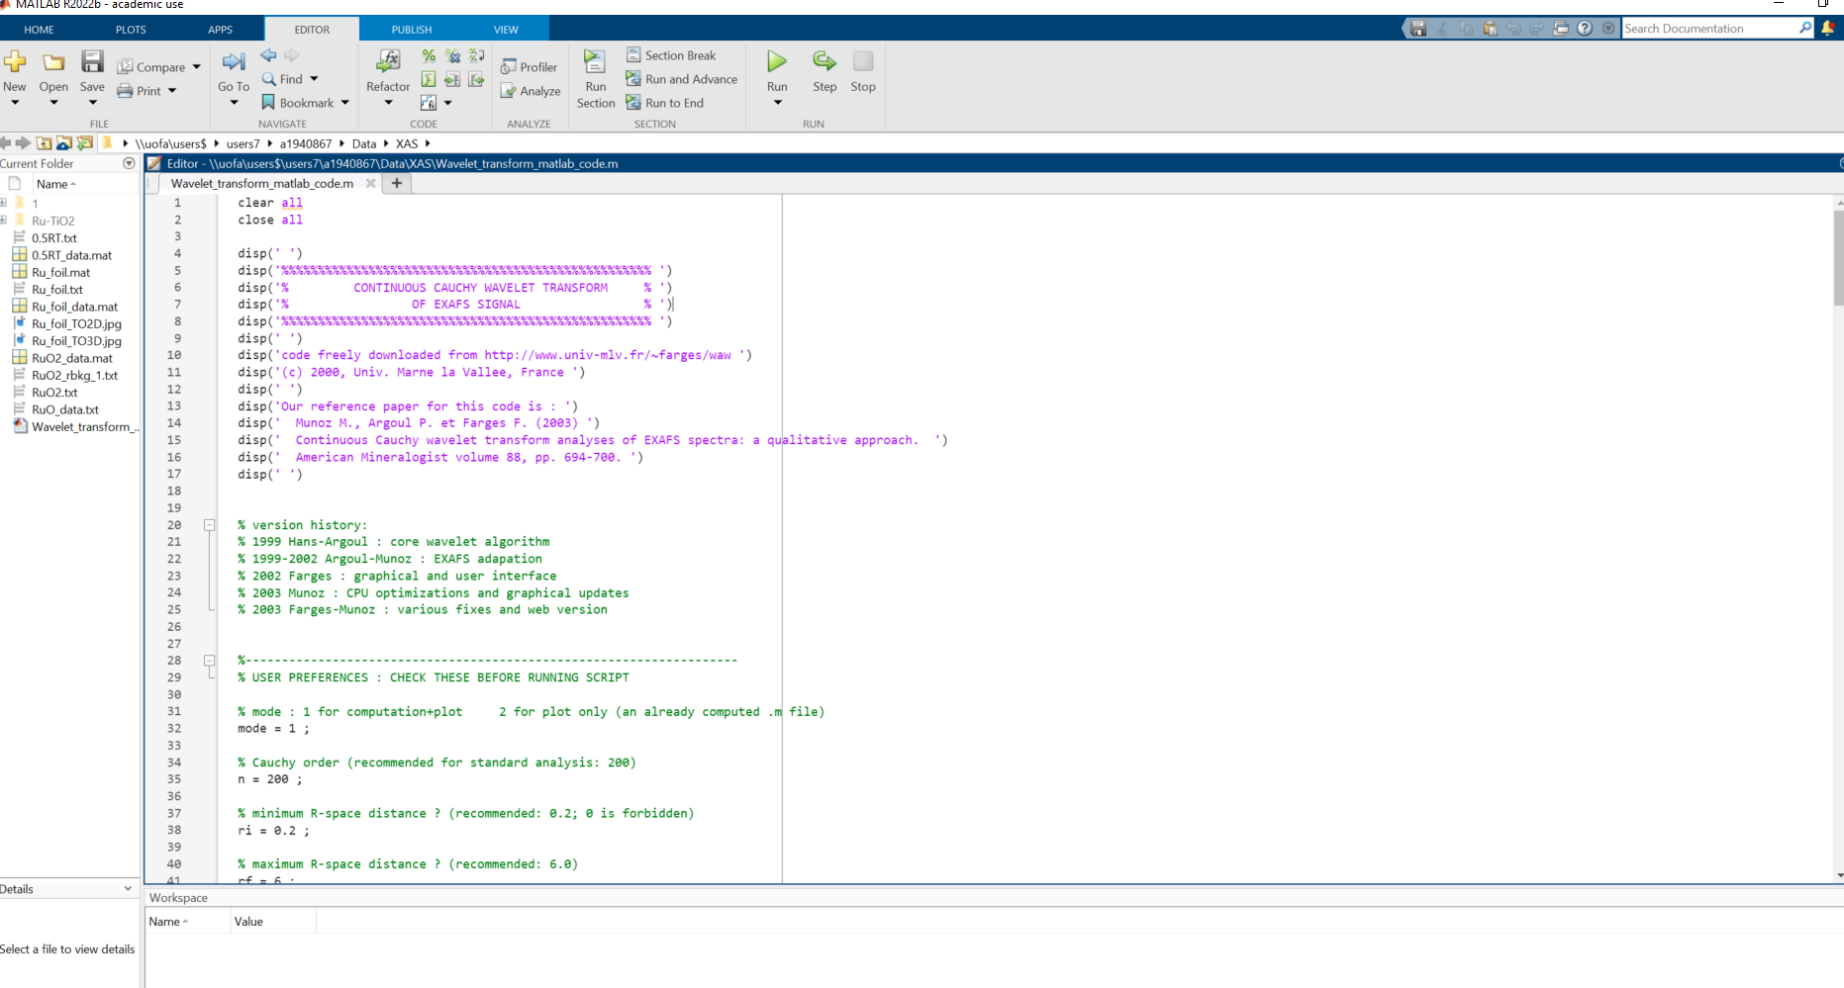
Matlab code
https://github.com/Tian9809/XAFS.git
You can find the matlab code for the wavelet transform by the link above.

Slide 14
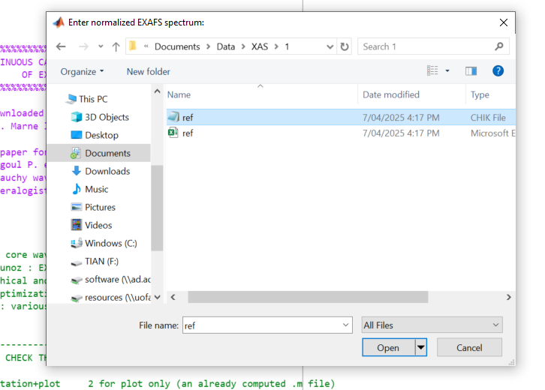
How to use the matlab code
Put the matlab code under the same directory with your k and chik text file.
Click “Run” and choose the text file you saved for k and chik data.

Slide 15
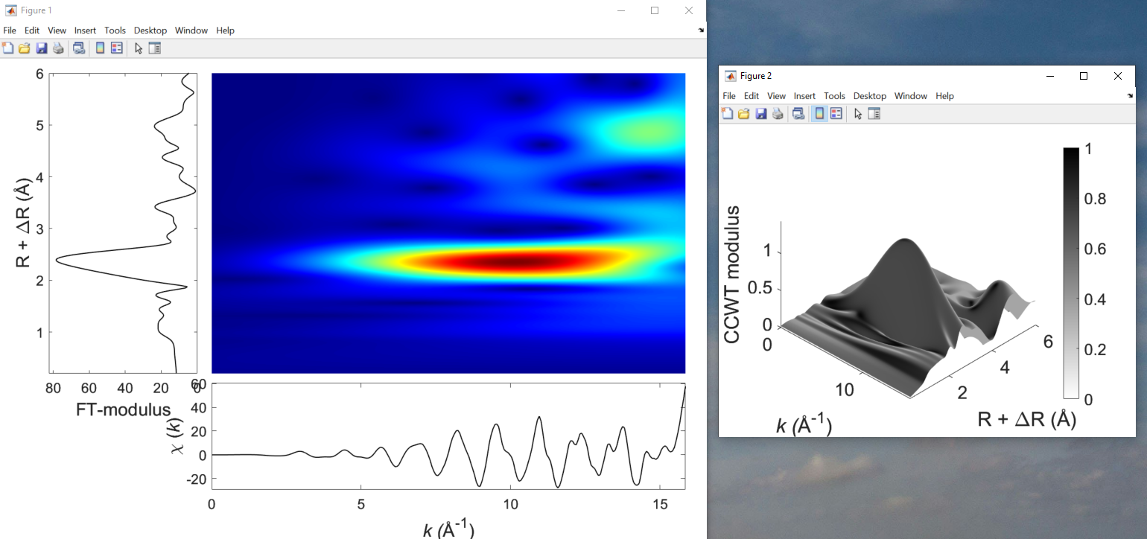
Then you will get

Slide 16
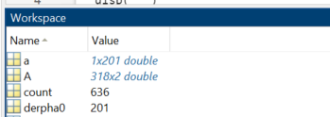
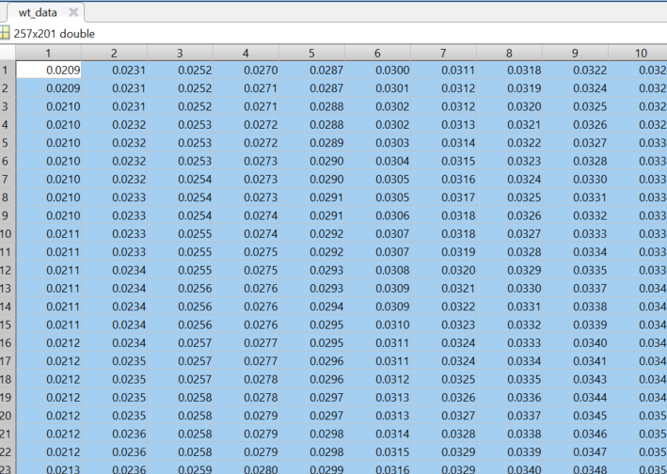
But not finish yet…
Go to this workspace panel in matlab
Find and double-click wt_data
Then copy all the data from this table

Slide 17
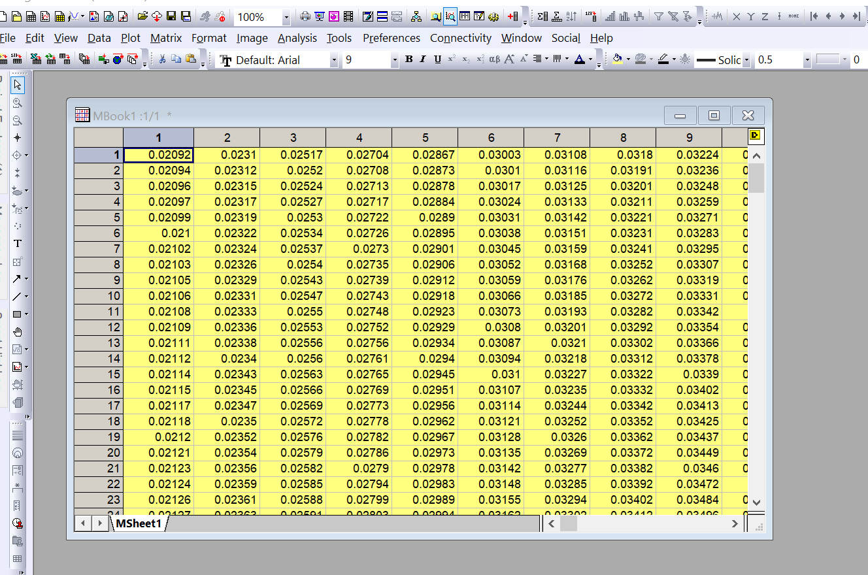
Open Origin
Create a matrix sheet and paste the copied wt_data in Matlab.
For create a new matrix sheet

Slide 18
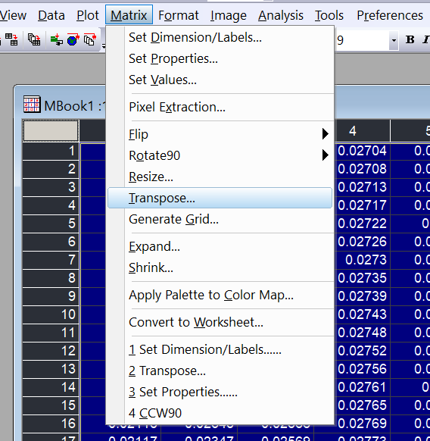
Transpose the data
Select all the data and go to “Matrix”- “Transpose”

Slide 19
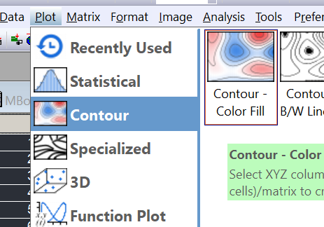
Plot
Then go to “Plot” – “Contour”

Slide 20
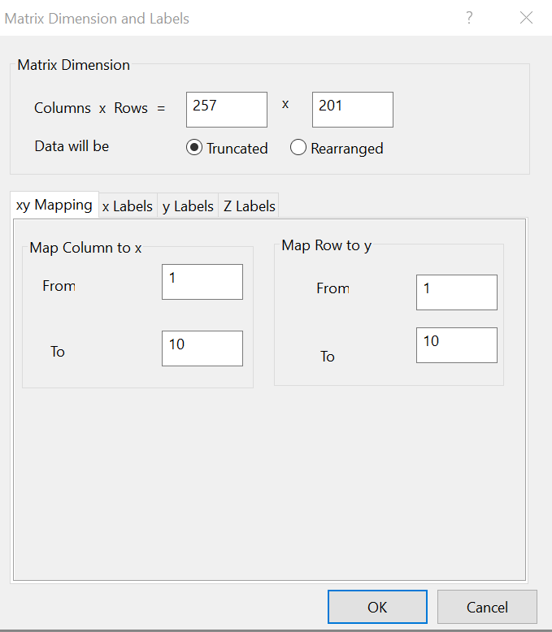
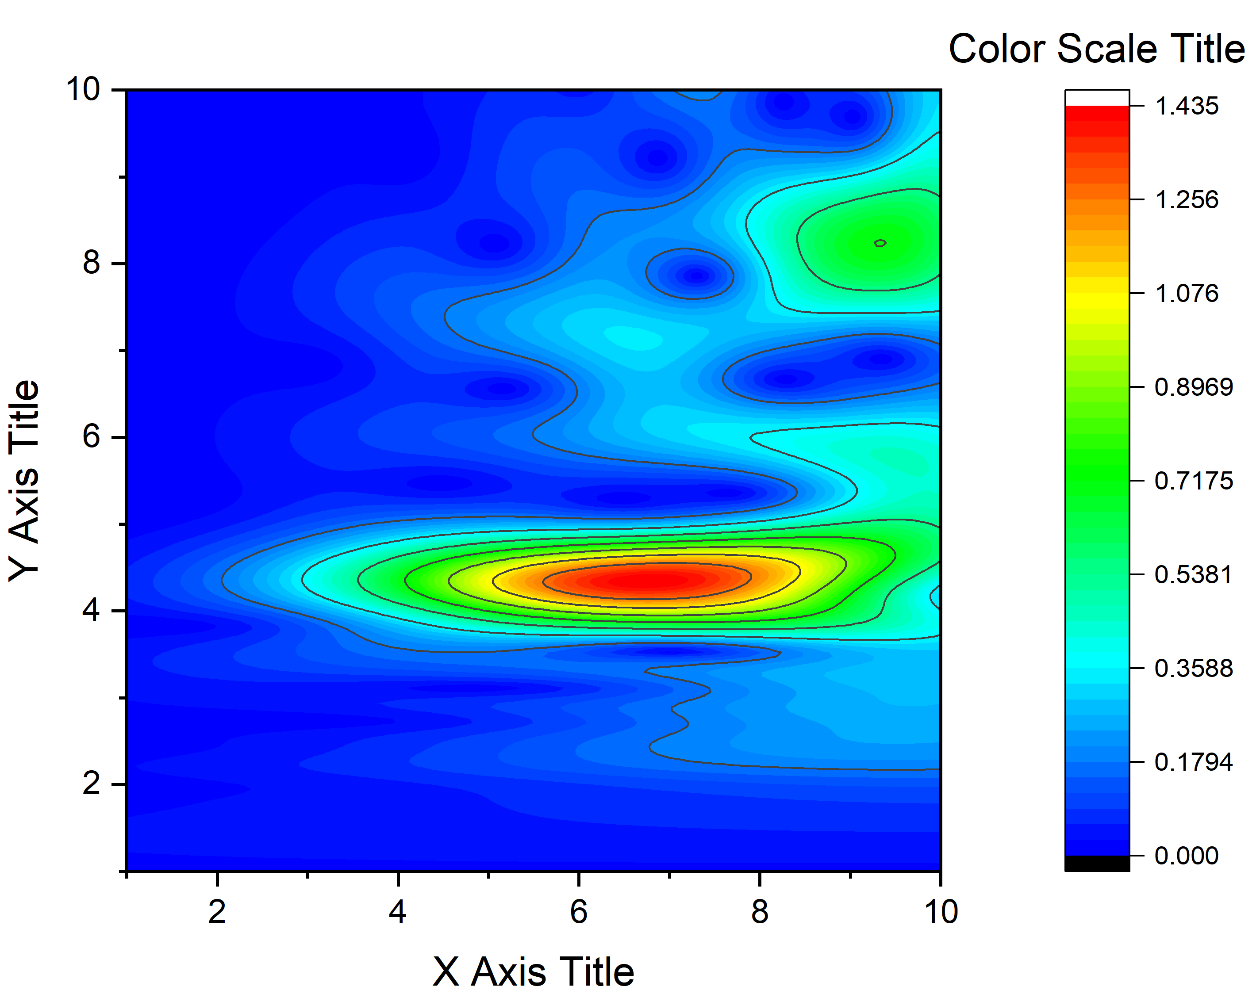
Finally, you will get,
Change the titles and adjust the scales for x axis by selecting all the matrix data and go to “matrix” – “Matrix dimensions and labels”
Depends on your k data range

Slide 21
Now it’s your time to play with your data

Slide 22
References and tutorials
https://www.yuque.com/xafs/tutorial/yyzu3f (Chinese)
https://www.bilibili.com/video/BV1yz411e7gu/?spm_id_from=333.337.search-card.all.click&vd_source=329aaeab02b65cf178a6d8e8e11273cf (Chinese)
Funke, H.; Scheinost, A. C.; Chukalina, M. Wavelet analysis of extended X-ray absorption fine structure data. Physical Review 2005, B 71, 094110.
Funke, H.; Chukalina, M.; Scheinost, A. C. A new FEFF-based wavelet for EXAFS data analysis. Journal of Synchrotron Radiation 2007, 14, 426-432.
https://users.rowan.edu/~polikar/WTtutorial.html

